Slide 1
RBF-NN
10867024 廖育賢

Slide 2
Training …

Slide 3
Training …

Slide 4
Number of Gaussian

Slide 5
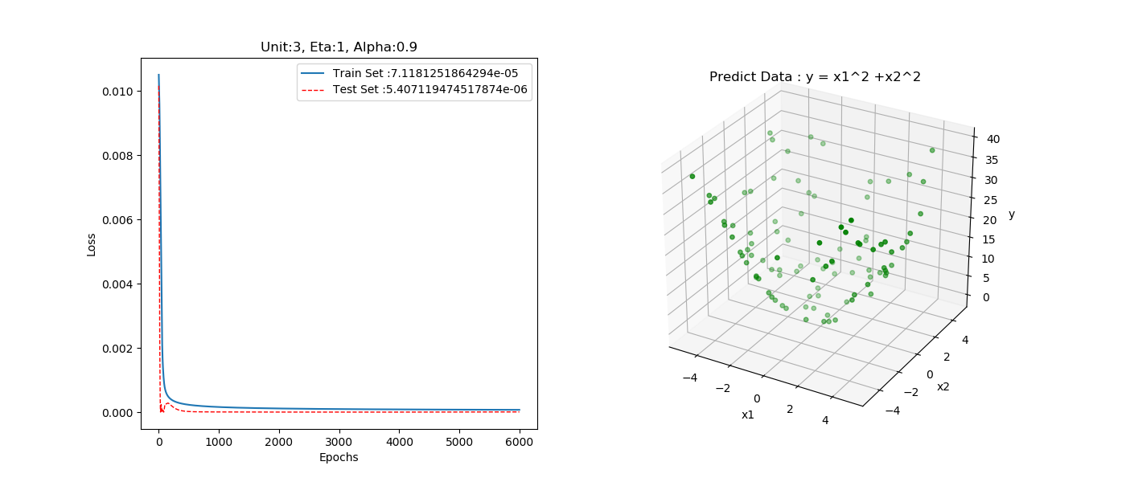

Slide 6
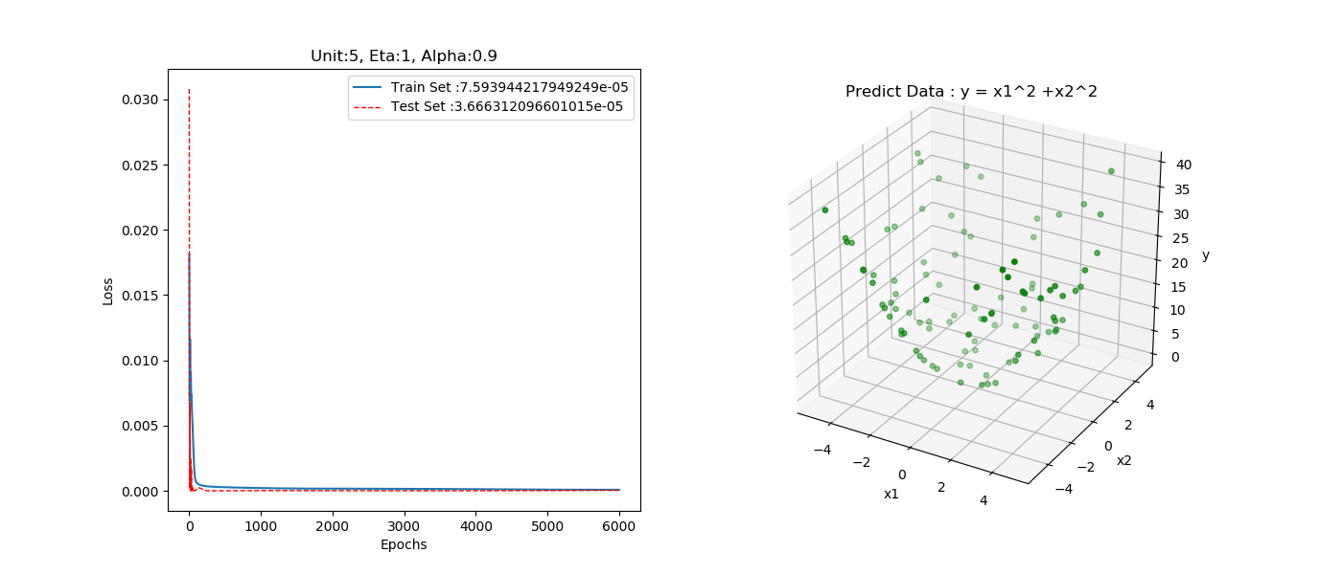

Slide 7
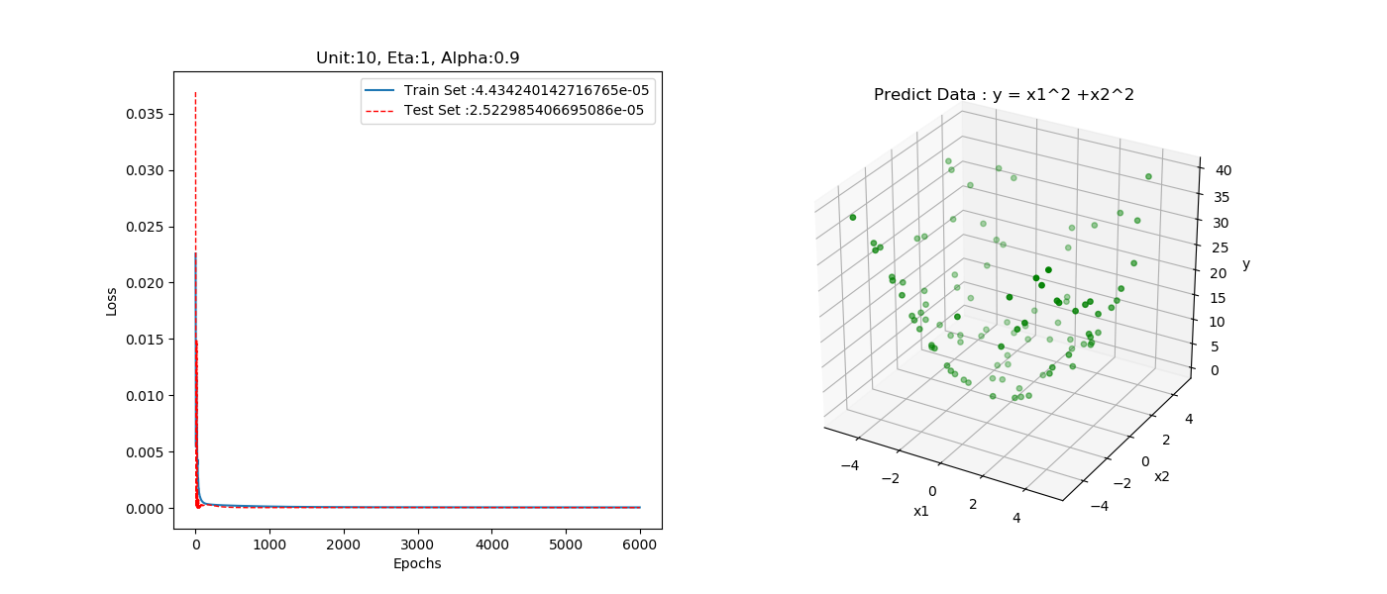

Slide 8
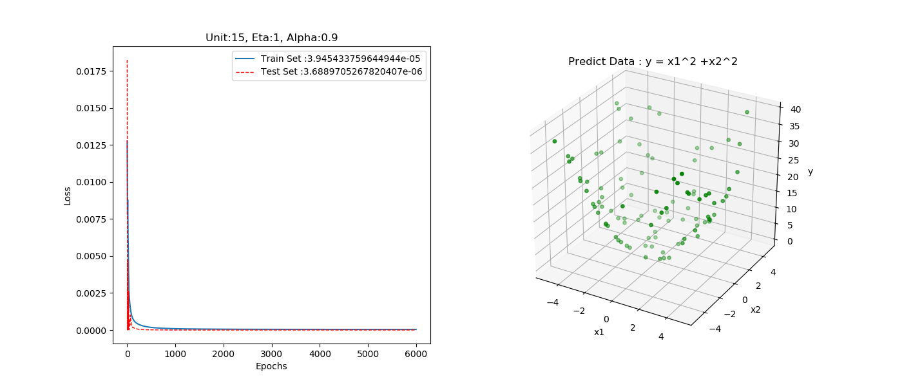

Slide 9
Eta

Slide 11
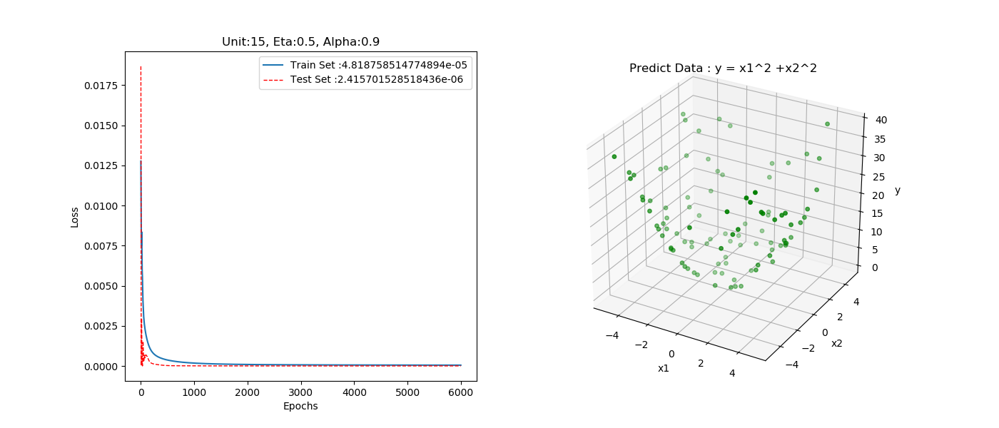

Slide 12
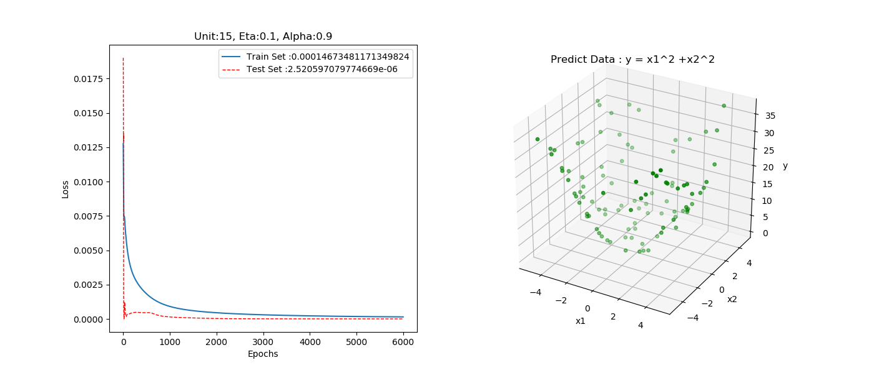

Slide 13
Alpha

Slide 14
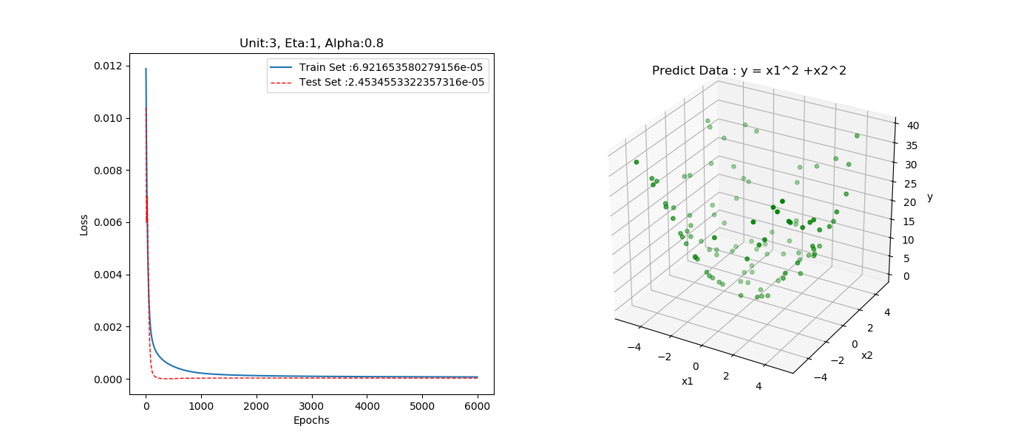

Slide 15


Slide 16


Slide 19
BPNN vs RBFN

Slide 20
RBFN

Slide 21
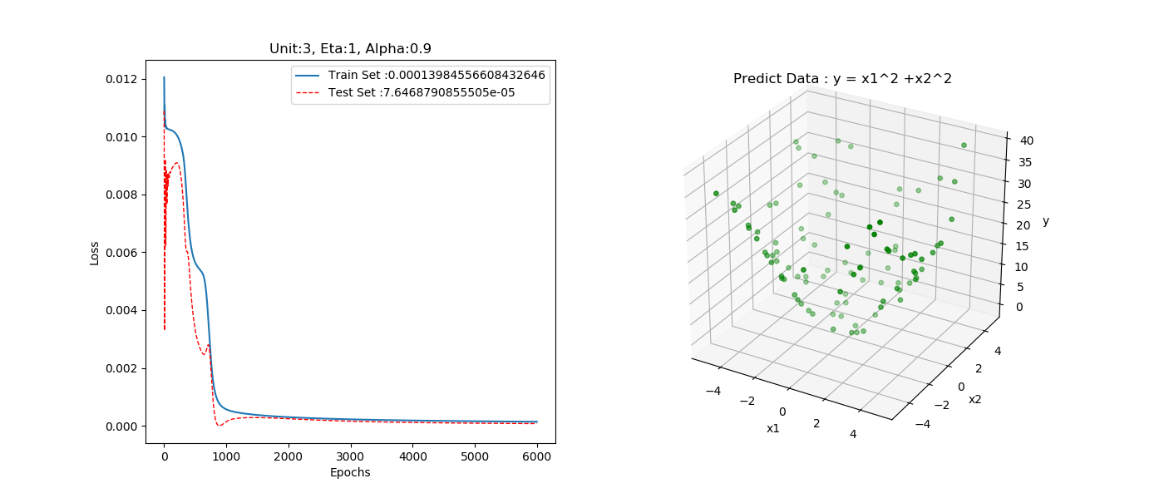
BPNN

